Slide 1
Chapter 5
Chapter 5
SNMPv1:
Communication and Functional Models
TNM
5-1

Slide 2
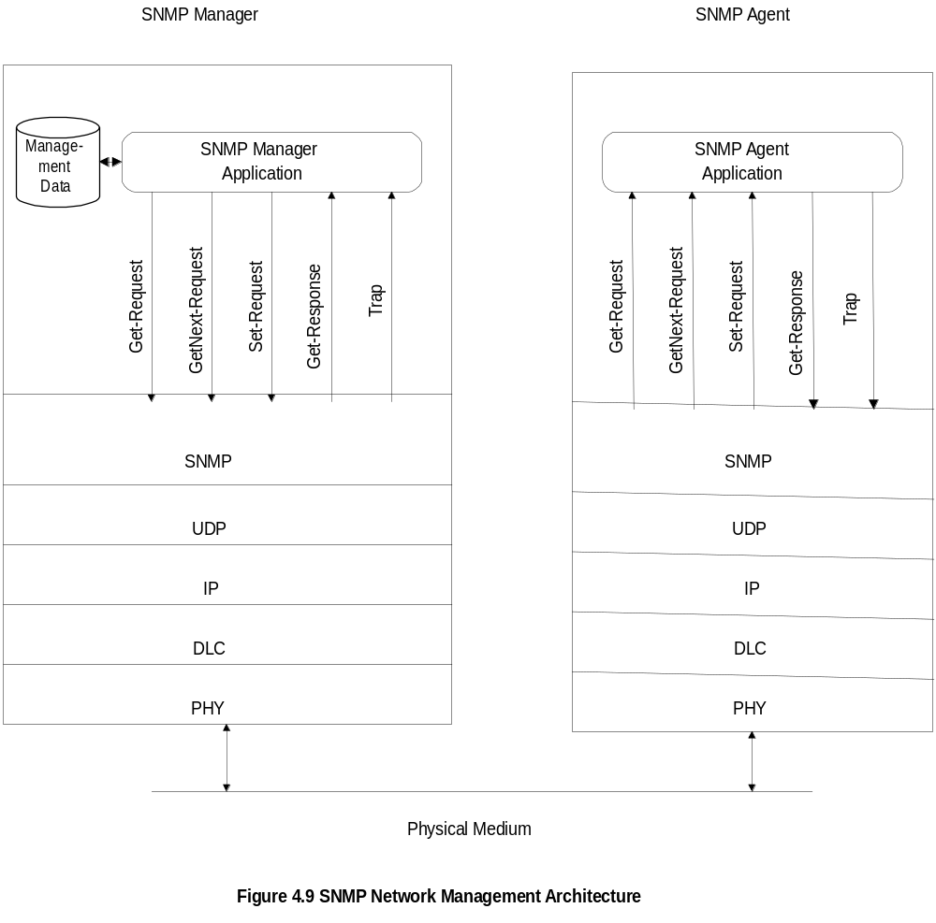
Chapter 5
SNMP Architecture
Notes
Truly simple network management protocol
Five messages, three from manager and two from agent
TNM
5-2

Slide 3
Chapter 5
SNMP Messages
Get-Request
Get-Next-Request
Set-Request
Get-Response
Trap
  Generic trap
  Specific trap
  Time stamp
Notes
Generic trap
  coldStart
  warmStart
  linkDown
  linkUp
  authenticationfailure
  egpNeighborLoss
  enterpriseSpecific
Specific trap
  for special measurements such as statistics
Time stamp: Time since last initialization
TNM
5-3

Slide 4
Chapter 5
Administrative Model
Based on community profile and policy
SNMP Entities:
  SNMP application entities
  - Reside in management stations and network
  elements
  - Manager and agent
  SNMP protocol entities
  - Communication processes (PDU handlers)
  - Peer processes that support application entities
Notes
TNM
5-4

Slide 5
SNMP is used for managing and monitoring network devices such as routers, switches and servers.
An SNMP trap is a message that’s sent from a network device to an SNMP management system without being solicited by the system.
The trap is triggered when a specific event or condition occurs on the device, such as a link going down, an authentication or a power failure.
The SNMP trap message contains information about the event or condition, such as the device and interface where the event occurred, the time the event occurred and the severity of the event.
TNM

Slide 6
Cold Start Trap: Generated when a network device has just been powered on or restarted. The SNMP manager can use this trap to detect when a device has rebooted. It can then take necessary actions such as checking the device’s configuration and status.
Warm Start Trap: Generated when a network device has been restarted without losing its configuration. The SNMP manager can use this trap to detect when a device has rebooted. After that, it can take action to check the device’s configuration and status.
Link Down Trap: Generated when a network interface on the device has gone down. The SNMP manager can use this trap to detect when a network link has failed and notify the appropriate personnel to investigate and resolve the issue.
TNM

Slide 7
Link Up Trap: Generated when a network interface on the device has come up. The SNMP manager can use this trap to detect when a network link has been restored and take actions such as reconfiguring the routing tables.
Authentication Failure Trap: Generated when a user authentication attempt has failed. The SNMP manager can use this trap to detect when an unauthorized user attempts to access the network. After detection, it can take actions like blocking the user’s IP address.
EGP Neighbor Loss Trap: Generated when a router loses an Exterior Gateway Protocol (EGP) routing protocol neighbor. It signals that a neighbor router is no longer available, indicating possible changes to the routing table. The SNMP manager can use this trap to recognize changes in the network and take action, such as updating routing tables.
TNM

Slide 8
Enterprise-Specific Traps
Enterprise-specific traps are customizable traps defined by the network administrator or the SNMP manager. These traps are used to indicate specific events or conditions in the network. Examples of specific traps include:
CPU Utilization Trap: This trap is generated when the CPU utilization of a network device exceeds a certain threshold. The SNMP manager can use this trap to detect potential performance issues on the device. It can then take necessary actions such as optimizing the device configuration or increasing the resources available to the device.
Interface State Change Trap: This trap is generated when the state of a network interface changes. The SNMP manager can use this trap to detect potential network disruptions. The manager can then take actions such as reconfiguring the network topology or investigating the cause of the interface state change.
TNM

Slide 9
Memory Utilization Trap: This trap is generated when the available memory on a device drops below a certain level. The SNMP manager can use this trap to detect potential performance issues on the device. After detection, the SNMP manager can take necessary actions such as optimizing the device configuration or increasing the resources available to the device.
Power Supply Failure Trap: This trap is generated when the power supply to a network device fails. The SNMP manager can use this trap to detect potential hardware failures on the device. After that, the SNMP manager can take actions such as replacing the failed component or device.
TNM

Slide 10
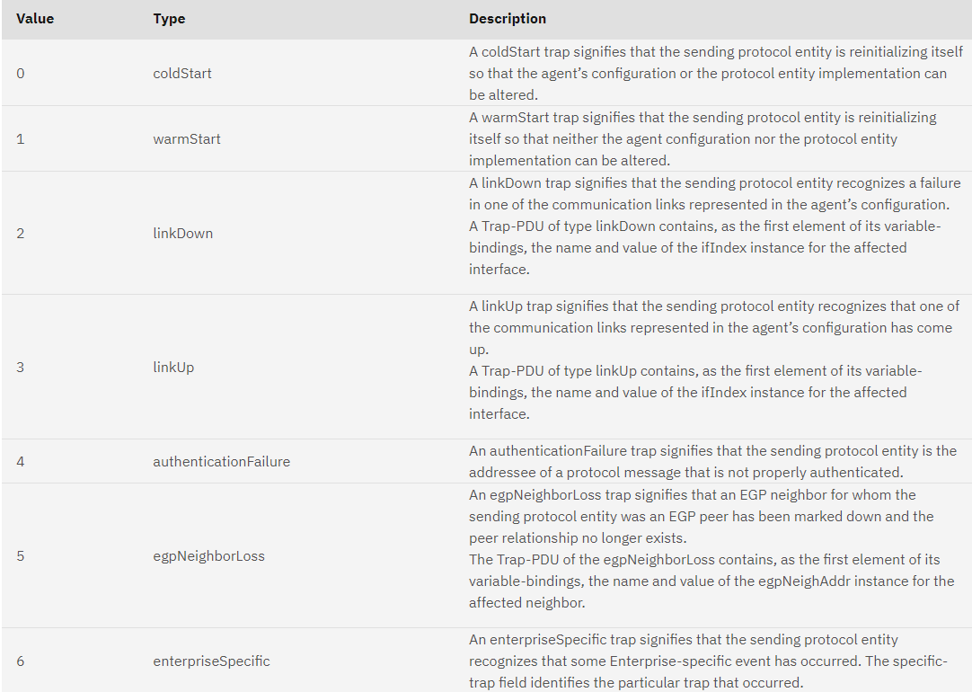
TNM

Slide 11
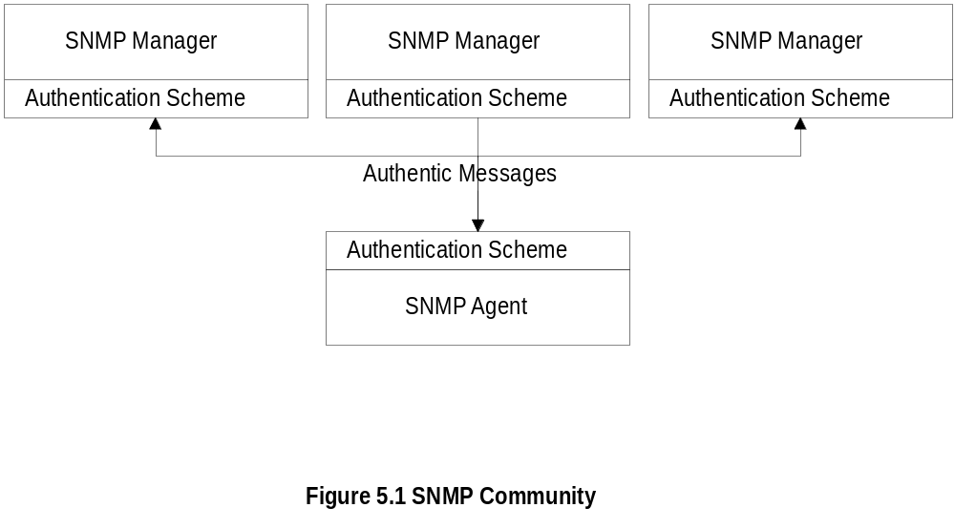
Chapter 5
SNMP Community
Notes
Security in SNMPv1 is community-based
Authentication scheme in manager and agent
Community: Pairing of two application entities
Community name: String of octets
Two applications in the same community
communicate with each other
Application could have multiple community names
Communication is not secured in SNMPv1 - no
encryption
TNM
5-5

Slide 12
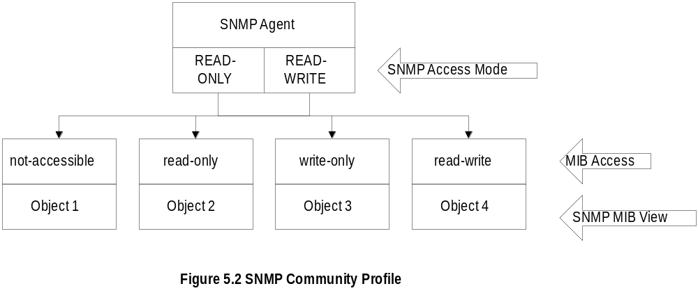
Chapter 5
Community Profile
Notes
MIB view
  An agent is programmed to view only a subset
  of managed objects of a network element
Access mode
  Each community name is assigned an access
  mode:: read-only and read-write
Community profile: MIB view + access mode
Operations on an object determined by community
profile and the access mode of the object
Total of four access privileges
Some objects, such as table and table entry are
non-accessible
TNM
5-6

Slide 13
Chapter 5
Administration Model
Administration model is SNMP access policy
SNMP community paired with SNMP
community profile is SNMP access policy
Notes
Parameters:
Community / communities
Agent / Agents
Manager / managers
TNM
5-7

Slide 14
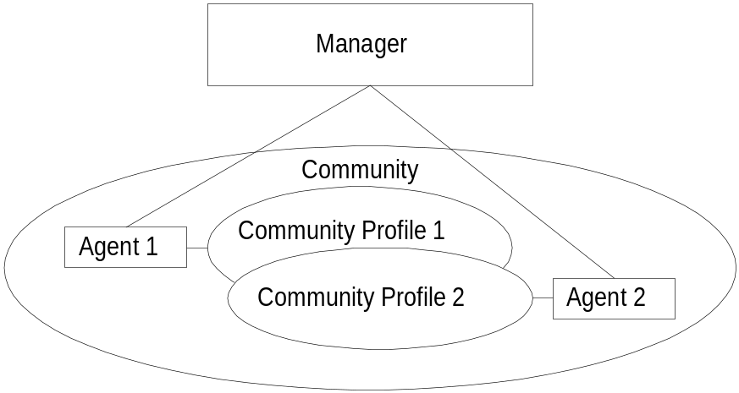
Chapter 5
Access Policy
Notes
Manager manages Community 1 and 2 network
components via Agents 1 and 2
Agent 1 has only view of Community Profile 1,
e.g. Cisco components
Agent 2 has only view of Community Profile 2,
e.g. 3Com components
Manager has total view of both Cisco and 3Com
components
TNM
5-8

Slide 15
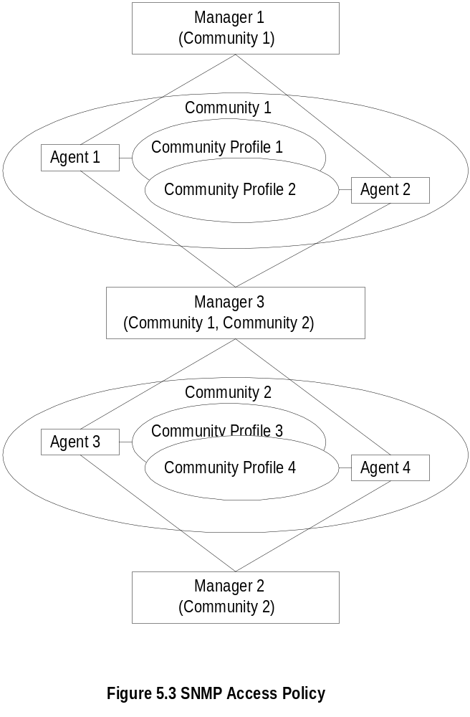
Chapter 5
Generalized Administration Model
Notes
Manager 1 manages community 1, manager 2
community 2,and manager 3 (MoM) both communities
1 and 2
TNM
5-9

Slide 16
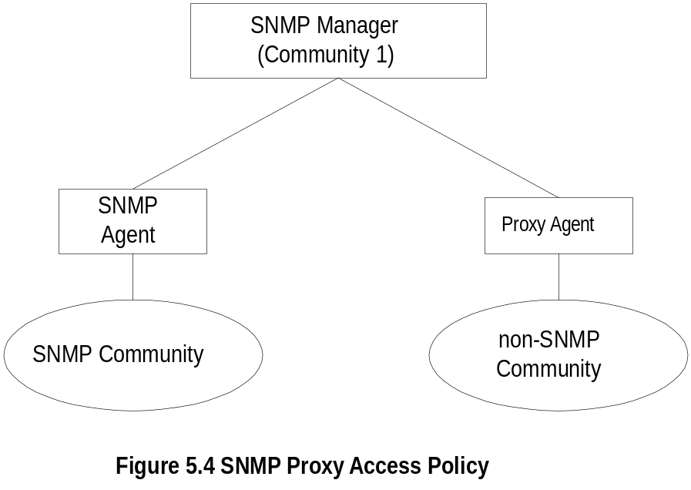
Chapter 5
Proxy Access Policy
Notes
Proxy agent enables non-SNMP community
elements to be managed by an SNMP manager.
An SNMP MIB is created to handle the non-SNMP
objects
TNM
5-10

Slide 17
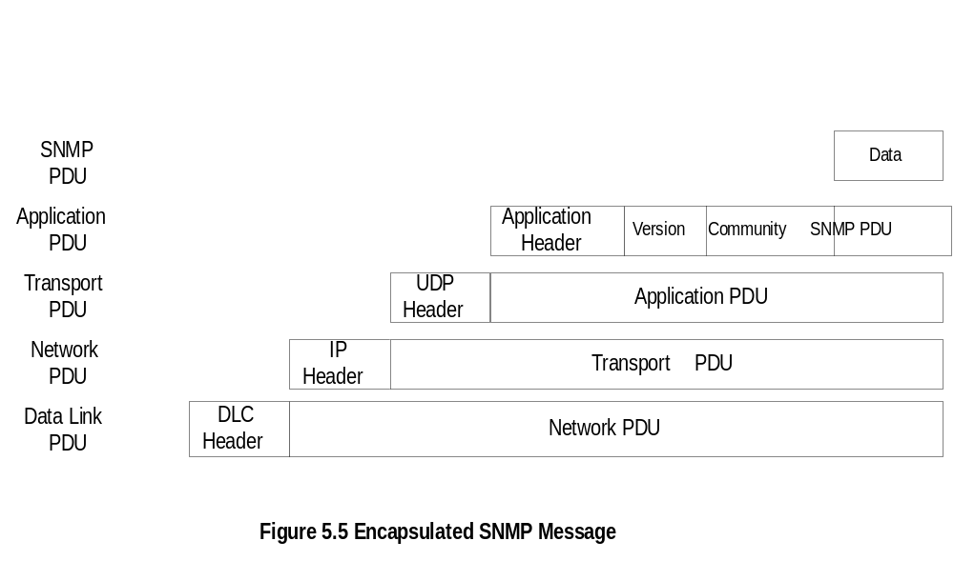
Chapter 5
Protocol Entities
Notes
Protocol entities support application entities
Communication between remote peer processes
Message consists of
  Version identifier
  Community name
  Protocol Data Unit
Message encapsulated and transmitted
TNM
5-11

Slide 18
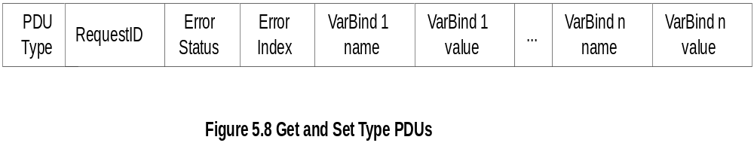
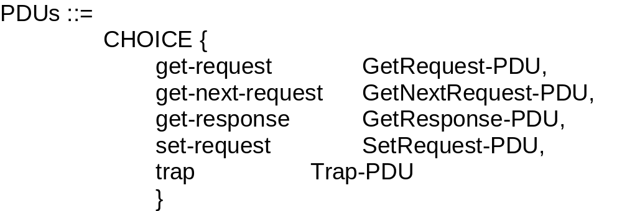
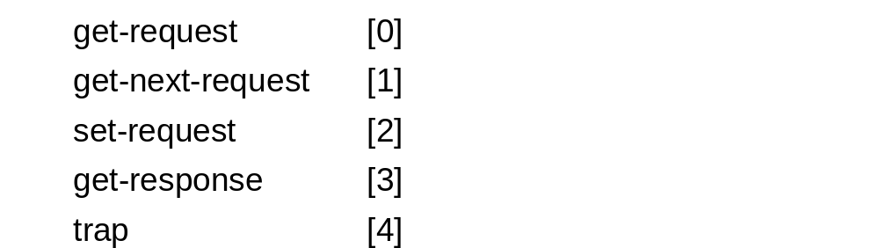
Chapter 5
Get and Set PDU
Notes
VarBindList: multiple instances of VarBind pairs
PDU Types: enumerated INTEGER
TNM
5-12

Slide 19
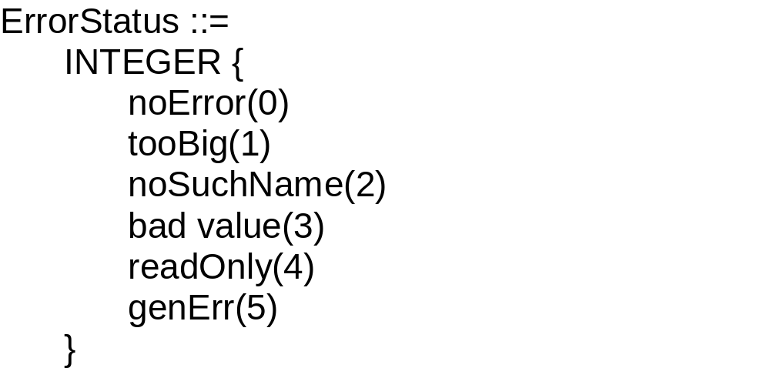
Chapter 5
Error in Response
Error Index: No. of VarBind that the first error occurred
Notes
TNM
5-13

Slide 20
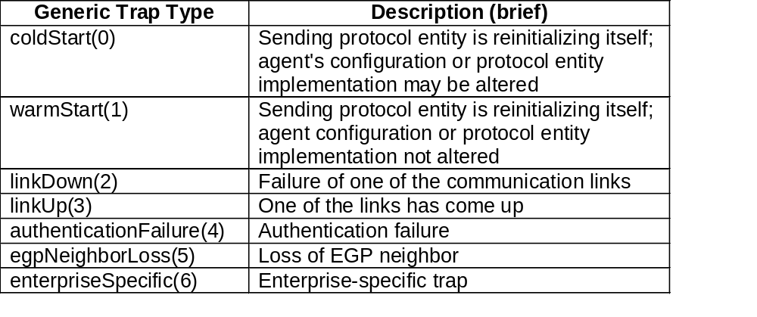
Chapter 5
Trap PDU
Notes
Enterprise and agent address pertain to the system
generating the trap
Seven generic traps specified by enumerated
INTEGER
Specific trap is a trap not covered by enterprise
specific trap
time stamp indicates elapsed time since last re-
initialization
TNM
5-14

Slide 21
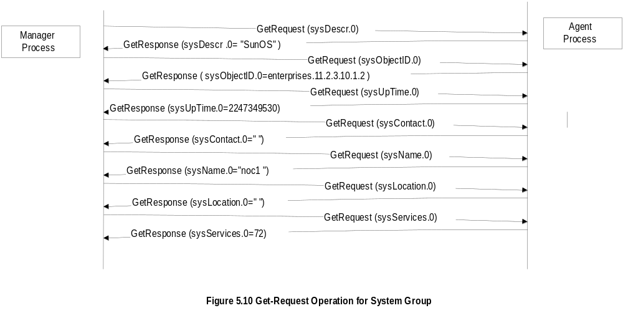
Chapter 5
SNMP Operations
TNM
5-15

Slide 22
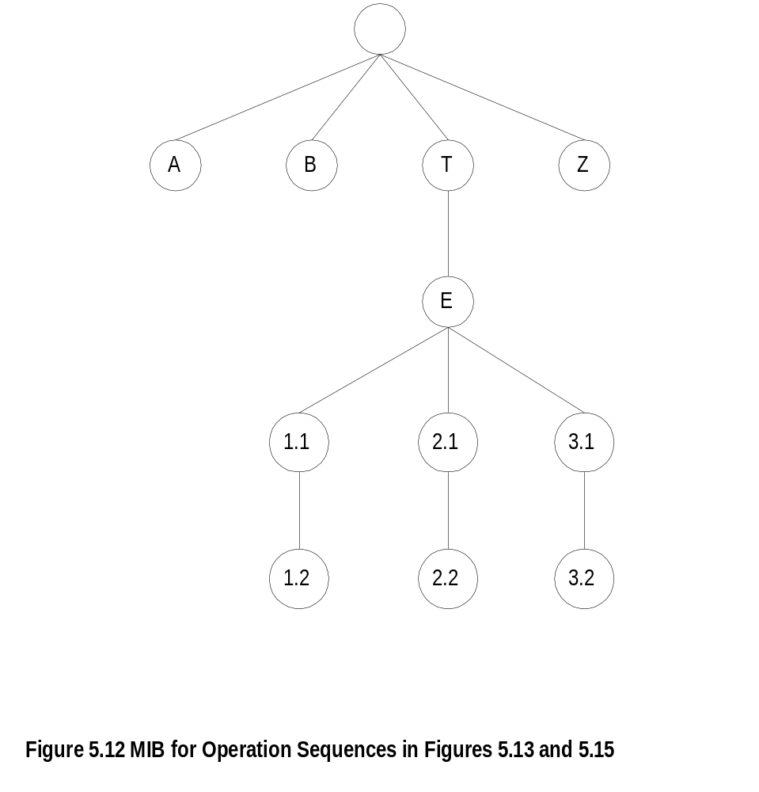
Chapter 5
MIB for Get-Next-Request
Notes
TNM
5-16

Slide 23
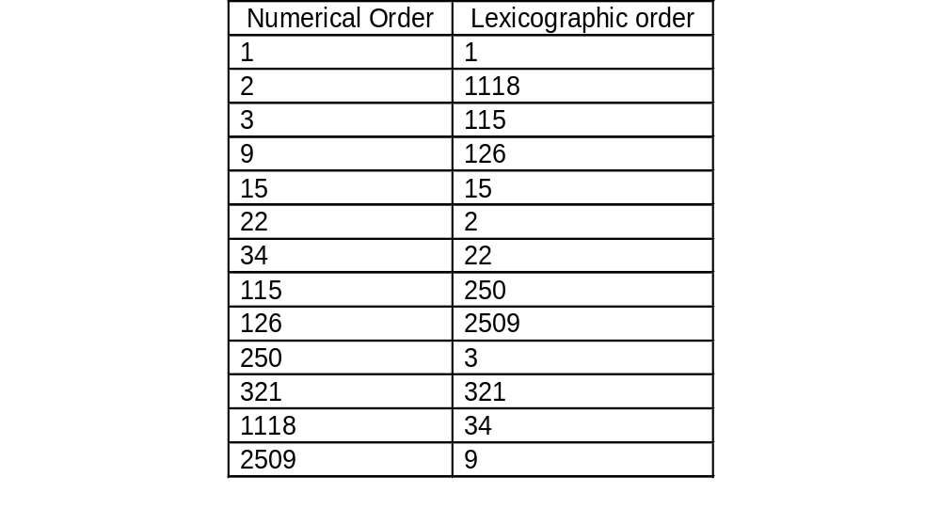
Chapter 5
Lexicographic Order
Notes
Procedure for ordering:
  Start with leftmost digit as first position
  Before increasing the order in the first position,
  select the lowest digit in the second position
  Continue the process till the lowest digit in
  the last position is captured
  Increase the order in the last position until all
  the digits in the last position are captured
  Move back to the last but one position and
  repeat the process
  Continue advancing to the first position until all
  the numbers are ordered
Tree structure for the above process
TNM
5-17

Slide 24
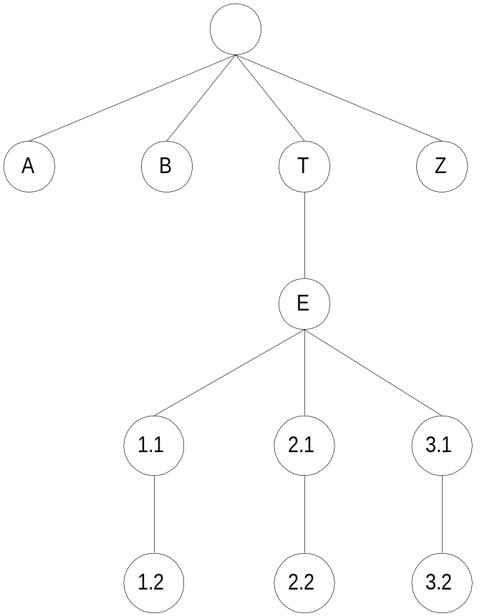
Chapter 5
MIB Lexicographic Order
Notes
A 3.1
B 3.2
T Z
E
1.1
1.2
2.1
2.2
TNM
5-18

Slide 25
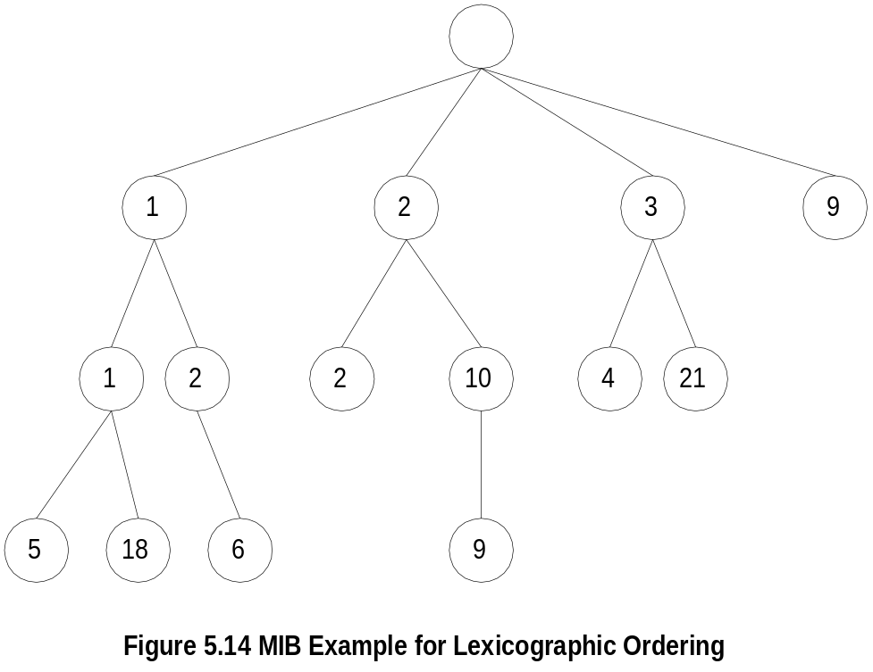
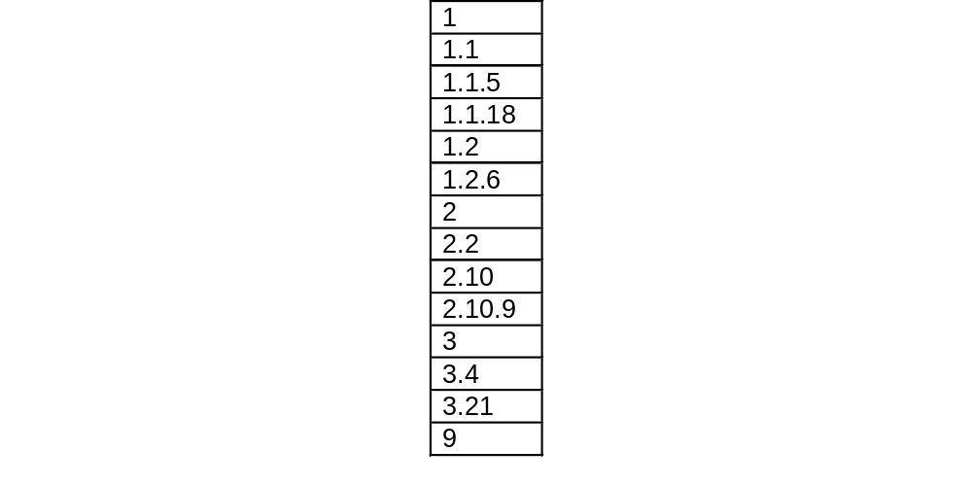
Chapter 5
A More Complex MIB Example
Notes
TNM
5-19

Slide 26
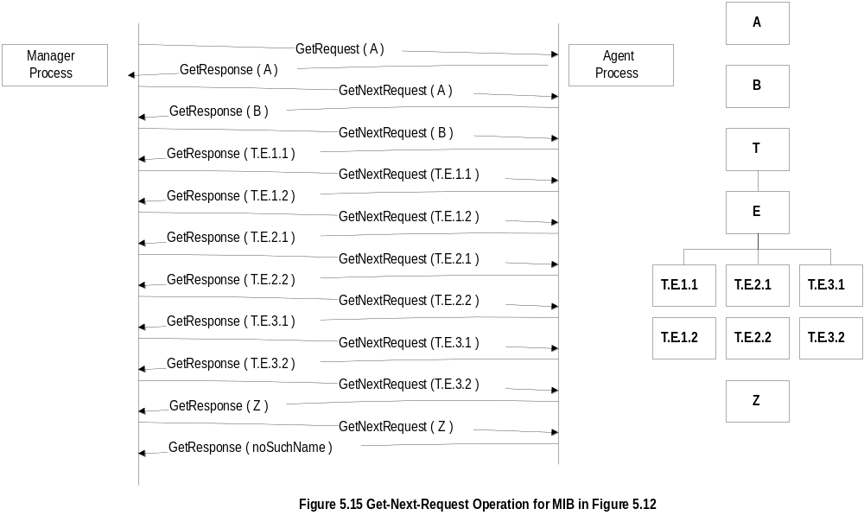
Chapter 5
Get-Next-Request Operation
TNM
5-20

Slide 27
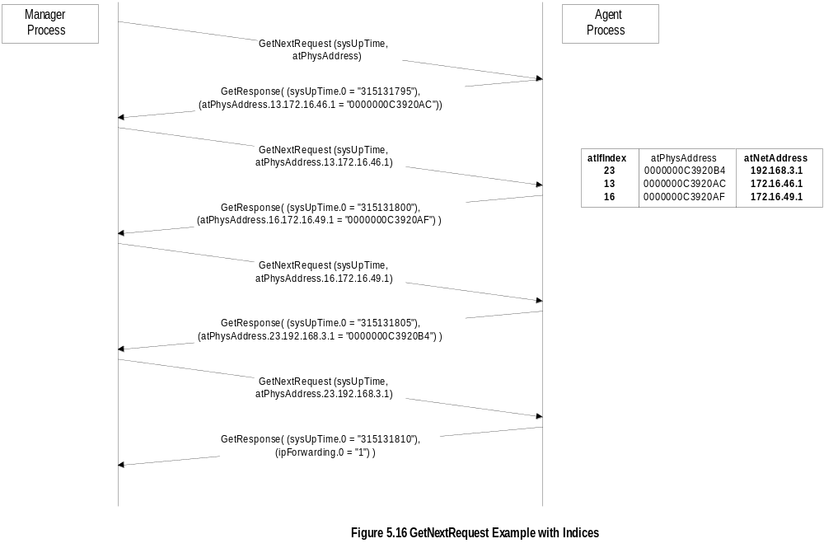
Chapter 5
Get-Next-Request Operation
TNM
5-21

Slide 28
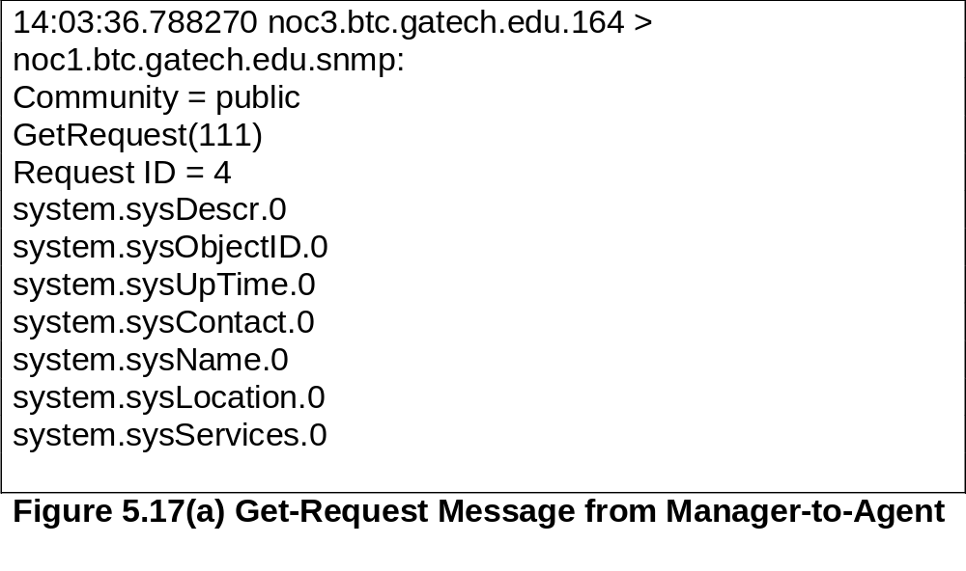
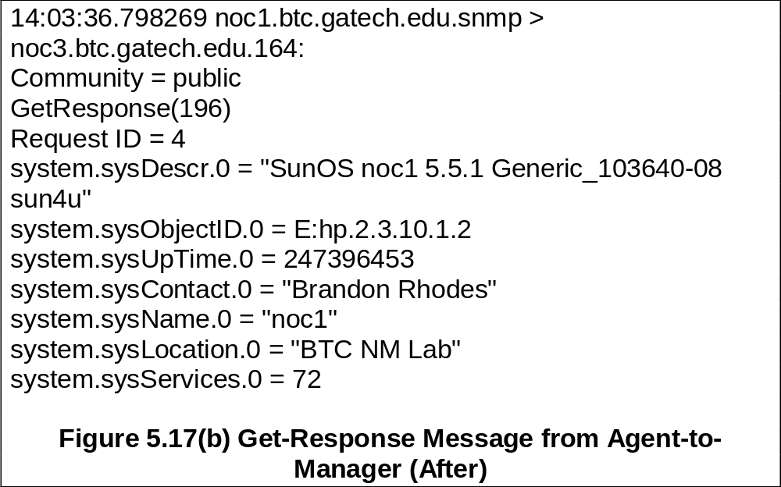
Chapter 5
Sniffer Data
TNM
5-22

Slide 29
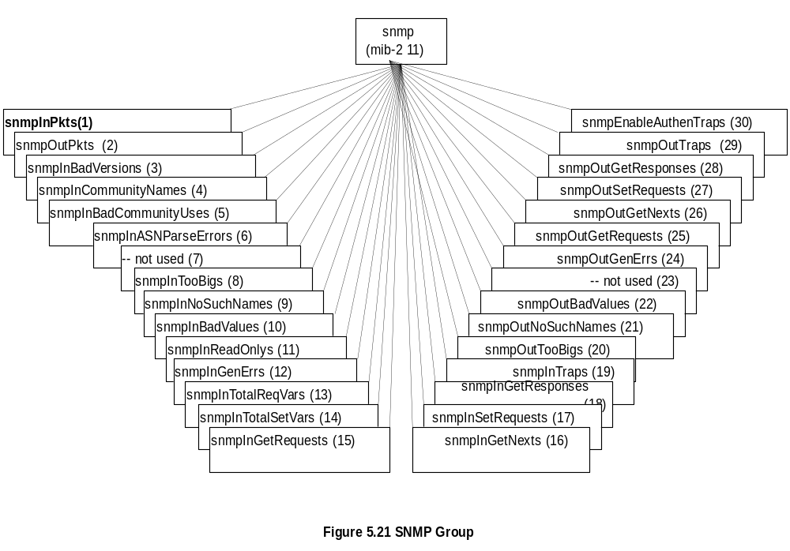
Chapter 5
SNMP MIB
Note: Most of the MIB objects were not used and hence deprecated in SNMPv2
TNM
5-23

